Slide 1
Shanghai Kooben Machinery Co.,Ltd
Your strategic sourcing partner for drilling tools in China

Slide 2



KOOBEN COMPANY OFFICE LOCATION
Building No.1, No.666 Zhangheng Road, Pudong district, Shanghai, China

Slide 3
THE FOUNDING OF KOOBEN
Kooben’s founder, Mr. Yang Xinqi, began his career over two decades ago as a drilling rig maintenance engineer. At the time, he experienced firsthand the unreliable performance of domestically produced drilling tools.
However, from his front-row seat in the industry, he witnessed a profound transformation. Through years of relentless innovation, China's leading manufacturers have evolved to produce world-class tools that now match and often surpass their international counterparts in quality, all while maintaining a significant cost advantage.
This unique insight - knowing who makes the best tools and why - is the foundation of Kooben.
Mr. Yang founded Kooben in 2018 with a clear mission: to act as a strategic partner of drilling tools for global customers, navigating the complexities of China's supply chain for them. We meticulously select products from elite manufacturers to deliver an unbeatable combination of performance, quality, and value. With Kooben, our partners can bypass the uncertainty and confidently access the very best the industry has to offer.
Our story

Slide 4

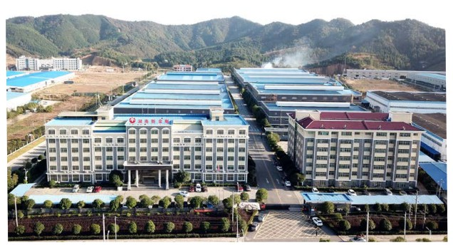
What We Do
Strategic Sourcing for Optimal Value: We partner with China's elite manufacturers, selecting the ideal supplier for each specific product to achieve the best possible balance of performance and cost.
Expert-Driven Customization: We leverage our deep technical expertise to specify product customizations and enhancements with our suppliers, improving quality and durability while maintaining competitive pricing.
Comprehensive OEM Solutions: We provide complete OEM solutions, allowing you to market a curated portfolio of top-tier tools under your brand. We are already the trusted OEM supplier for several prominent drilling rig manufacturers.
Dedicated End-to-End Support: We take full responsibility for the quality of our products. Our dedicated product and customer service teams are here to support you with any pre-sales and after-sales needs.

Slide 5

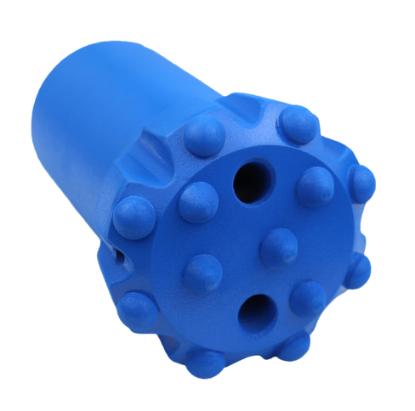
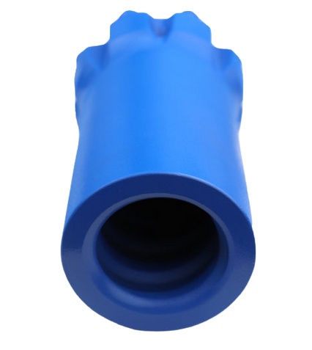
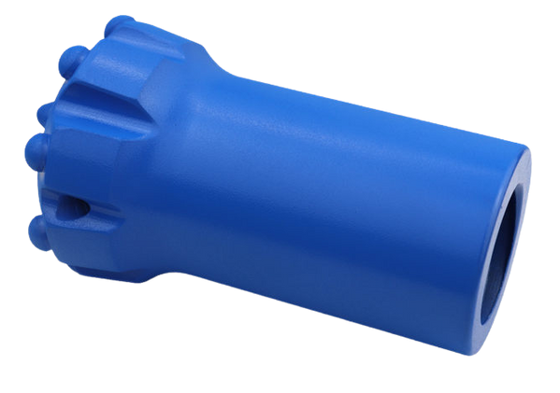
Drill Bits
The complete range of drill bits includes those used with top hammer and DTH drilling methods.

Slide 6

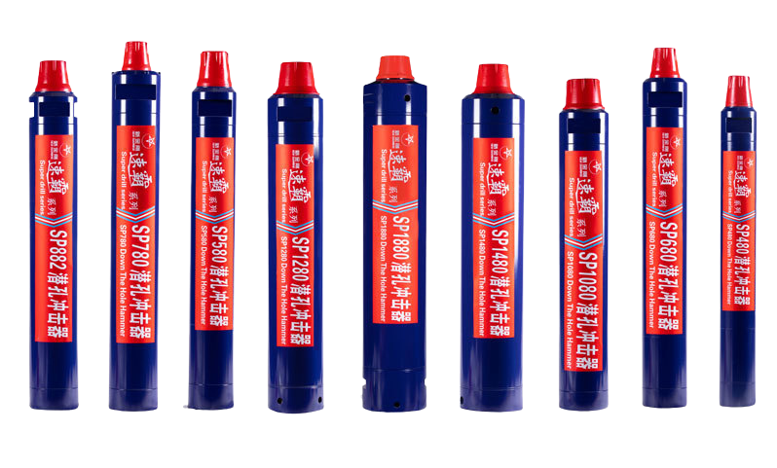
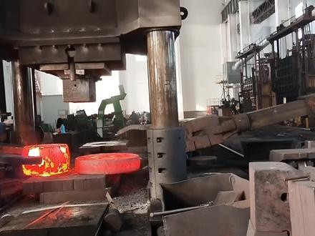
Down the Hole
Hammer (DTH)
Every Size, Every Shank, Every Application.

Slide 7
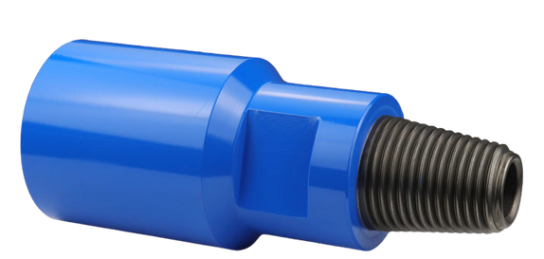
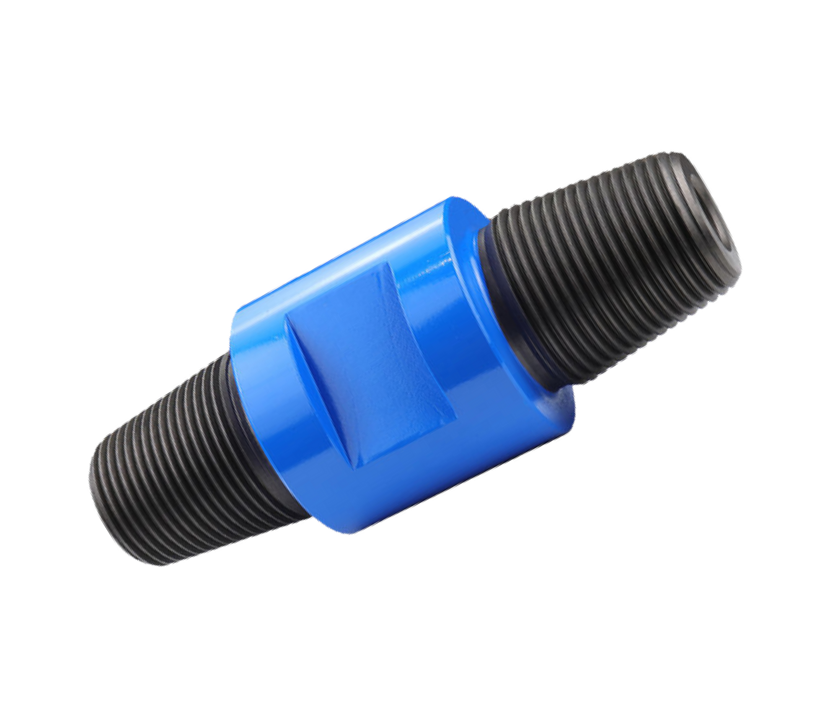
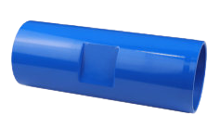
Drill Rod Adapter
Pin-Box Adapter
We supply all standard and custom drill rod adapters
Pin-Pin Adapter
Box-Box Adapter

Slide 8
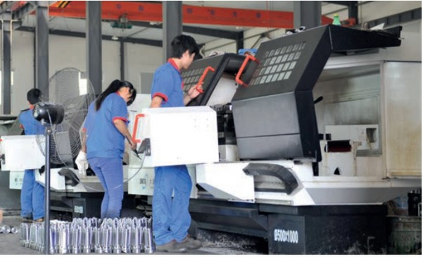
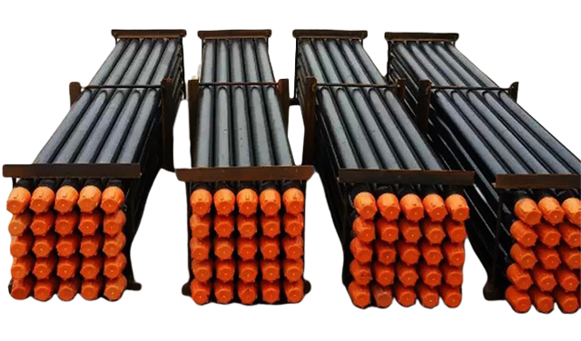
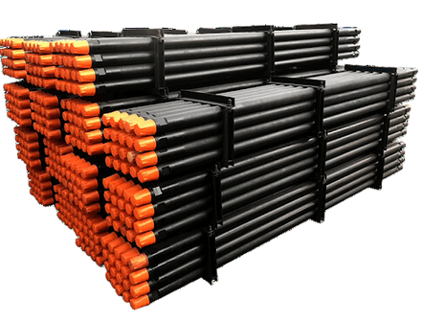
Our portfolio includes a comprehensive range of friction-welded drill pipes.
Drill Pipe
.

Slide 9
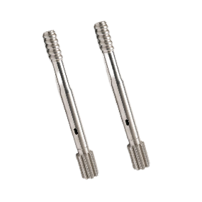
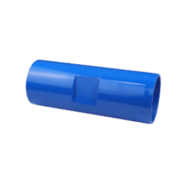
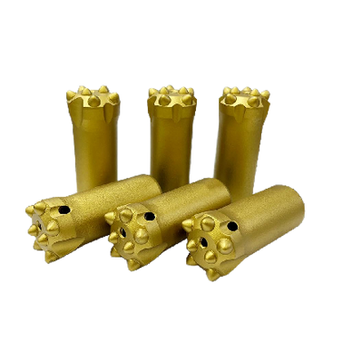
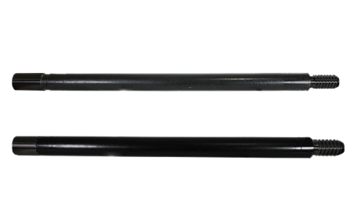
Customization
Kooben offers professional consultation and customized products according to customers' needs.

Slide 10


Pain Points
When sourcing from a foreign country such as China
01
The Discovery & Vetting Problem
The challenge of balancing quality and price, when you do not know which supplier’s claims are valid
02
The Management Problem
The complexity of supply chain management, especially when dealing with multiple suppliers
03
The Assurance Problem
Lack of support and expertise that guarantees the quality, and solves technical issues as they arise

Slide 11

Our solution
How do we help you solve those issues
01
We provide vetted quality and competitive value from day one
Curated & Vetted Supplier Portfolio
Competitive Pricing Through Volume Leverage
Rigorous, In-House Quality Assurance (QA)
02
We act as your single, integrated supply chain hub
A Single Point of Contact
"Best-of-Breed" Product Integration
Seamless Logistics & Consolidation
03
We provide comprehensive support and take full accountability
Expert Pre-Sales Technical Consultation
Unified After-Sales Support & Accountability
A Long-Term Partnership, Not a One-Time Transaction

Slide 12






Customer reviews
DAVIN KATO
DENZEL
TOMAS
Very professional and quick responses by the sales manager, Jose, would recommend Kooben to anyone
Kooben‘s service is excellent. On-time shipment, and very satisfied with the quality of the drilling tools
Kooben provides excellent drilling parts. Their team can customize the drill parts according to my request. When we have difficulties during the process, Mr.Chen is very patient in solving my problems

Slide 13

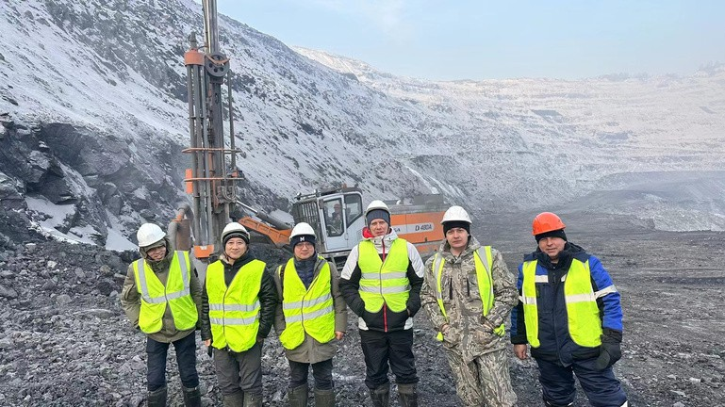
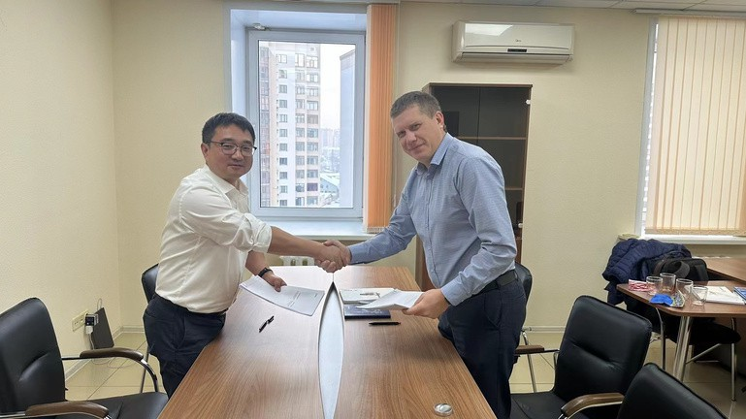
01
Company: ALTAIBURMASH
CEO: Stanislav
Customer
story
Country: Russia
The case hardening technique ensures that pipe threads extend at least 50% longer lifetime
Friction welded technology eliminates the need for shrink fitting, ensuring less weight and lasting life lifespan.
5-year contract signed to cover the full range of products from DTH to Top hammer drilling tools

Slide 14


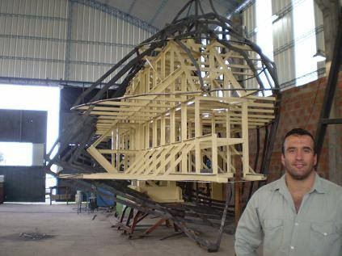
02
Company: AsistecMinera
CEO: Tomas Fabian
Customer
story
Country: Argentina
Strict control from the casting, machining, assembly, to inspection
Competitive price with better service and support
State-of-the-art material requirement
7 years of cooperation

Slide 15

Email
info@koo-ben.com
Get in touch
Website
www.koo-ben.com
Phone number
+86 136 6171 2390

